Slide 2


Slide 3

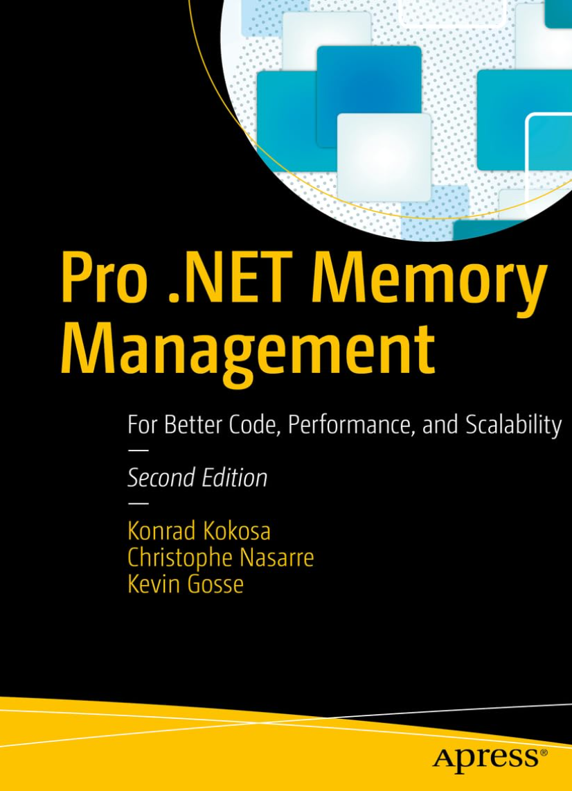


.NET CLI tools in the AI fury
Christophe Nasarre
Senior Developer at Datadog
Twitter @chnasarre
@chrisnas.bsky.social
Notes:
SETUP
Open prompt in C:\Conferences\2026_CLItools\dumps
Open prompt in C:\Conferences\2026_CLItools\Code\GuidGen
Open Windows explorer in C:\Users\Christophe Nasarre\.nuget\packages for dnx
Open Process Explorer
Open VS 2026
load C:\github\chrisnas\BucharestSoftwareArchitectureSummit2026\Code\CLITools.slnx
Open VS 2022
load C:\github\chrisnas\DebuggingExtensions\src\DebuggingExtensions.sln
Open DuplicatedStringsTool.cs
Open Program.cs
Open VS 2022
Load C:\github\chrisnas\GCStats\GCStats\GCStats.sln
Open dotnet-fullgc\Program.cs
Open https://www.nuget.org/
Open C:\Users\Christophe Nasarre\.cursor\skills\dotnet-memory-analysis\SKILL.md

Slide 4
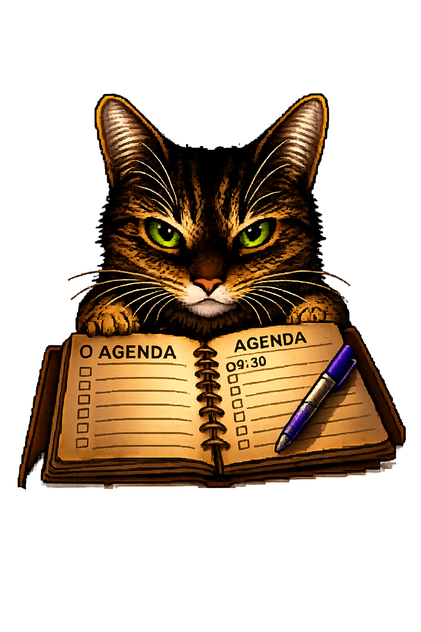
Agenda
Building CLI tools
Looking into .NET
AI loves CLI
Basics
Versioning
Beyond
TraceEvent
ClrMD
Commands
MCP server
Skills

Slide 5
What are .NET CLI tools?
= “console” apps distributed as NuGet packages with dotnet tool install
.NET SDK is required to install tools
  … but Microsoft is working on it!
List installed tools with dotnet tool list -g DEMO
  Local tools are also possible (for controlled versioning with manifest file; ex: CI)

Slide 6
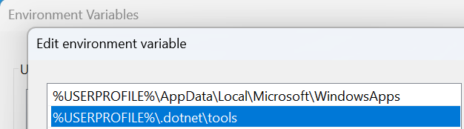
Run my CLI tool
<tool name>
  dotnet-dump to start dotnet-dump …because the folder is added to the PATH
dotnet <tool name without dash>
  dotnet dump to start dotnet-dump
Where are they installed on disk? DEMO
  shim =
  c:\users\<user>\.dotnet\tools\<tool name>.exe
  real =
  c:\users\<user>\.dotnet\tools\.store\<tool name>\<version>\net<runtime version>\any\<tool name>.dll
  … but could be set with --tool-path

Slide 7
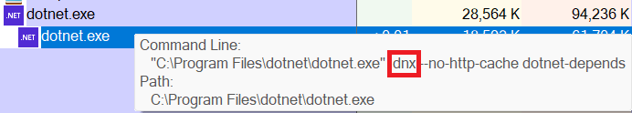
Run my CLI tool (please)
Strong runtime version association
  û Tools older than the runtime version
Use --allow-roll-forward
  …when a tools is older than the runtime version
(.NET 10) dnx
  Download, run and discard
  Like npx for .NET
  Keep a cache in C:\Users\<current user>\.nuget\packages\<tool name>

Slide 8
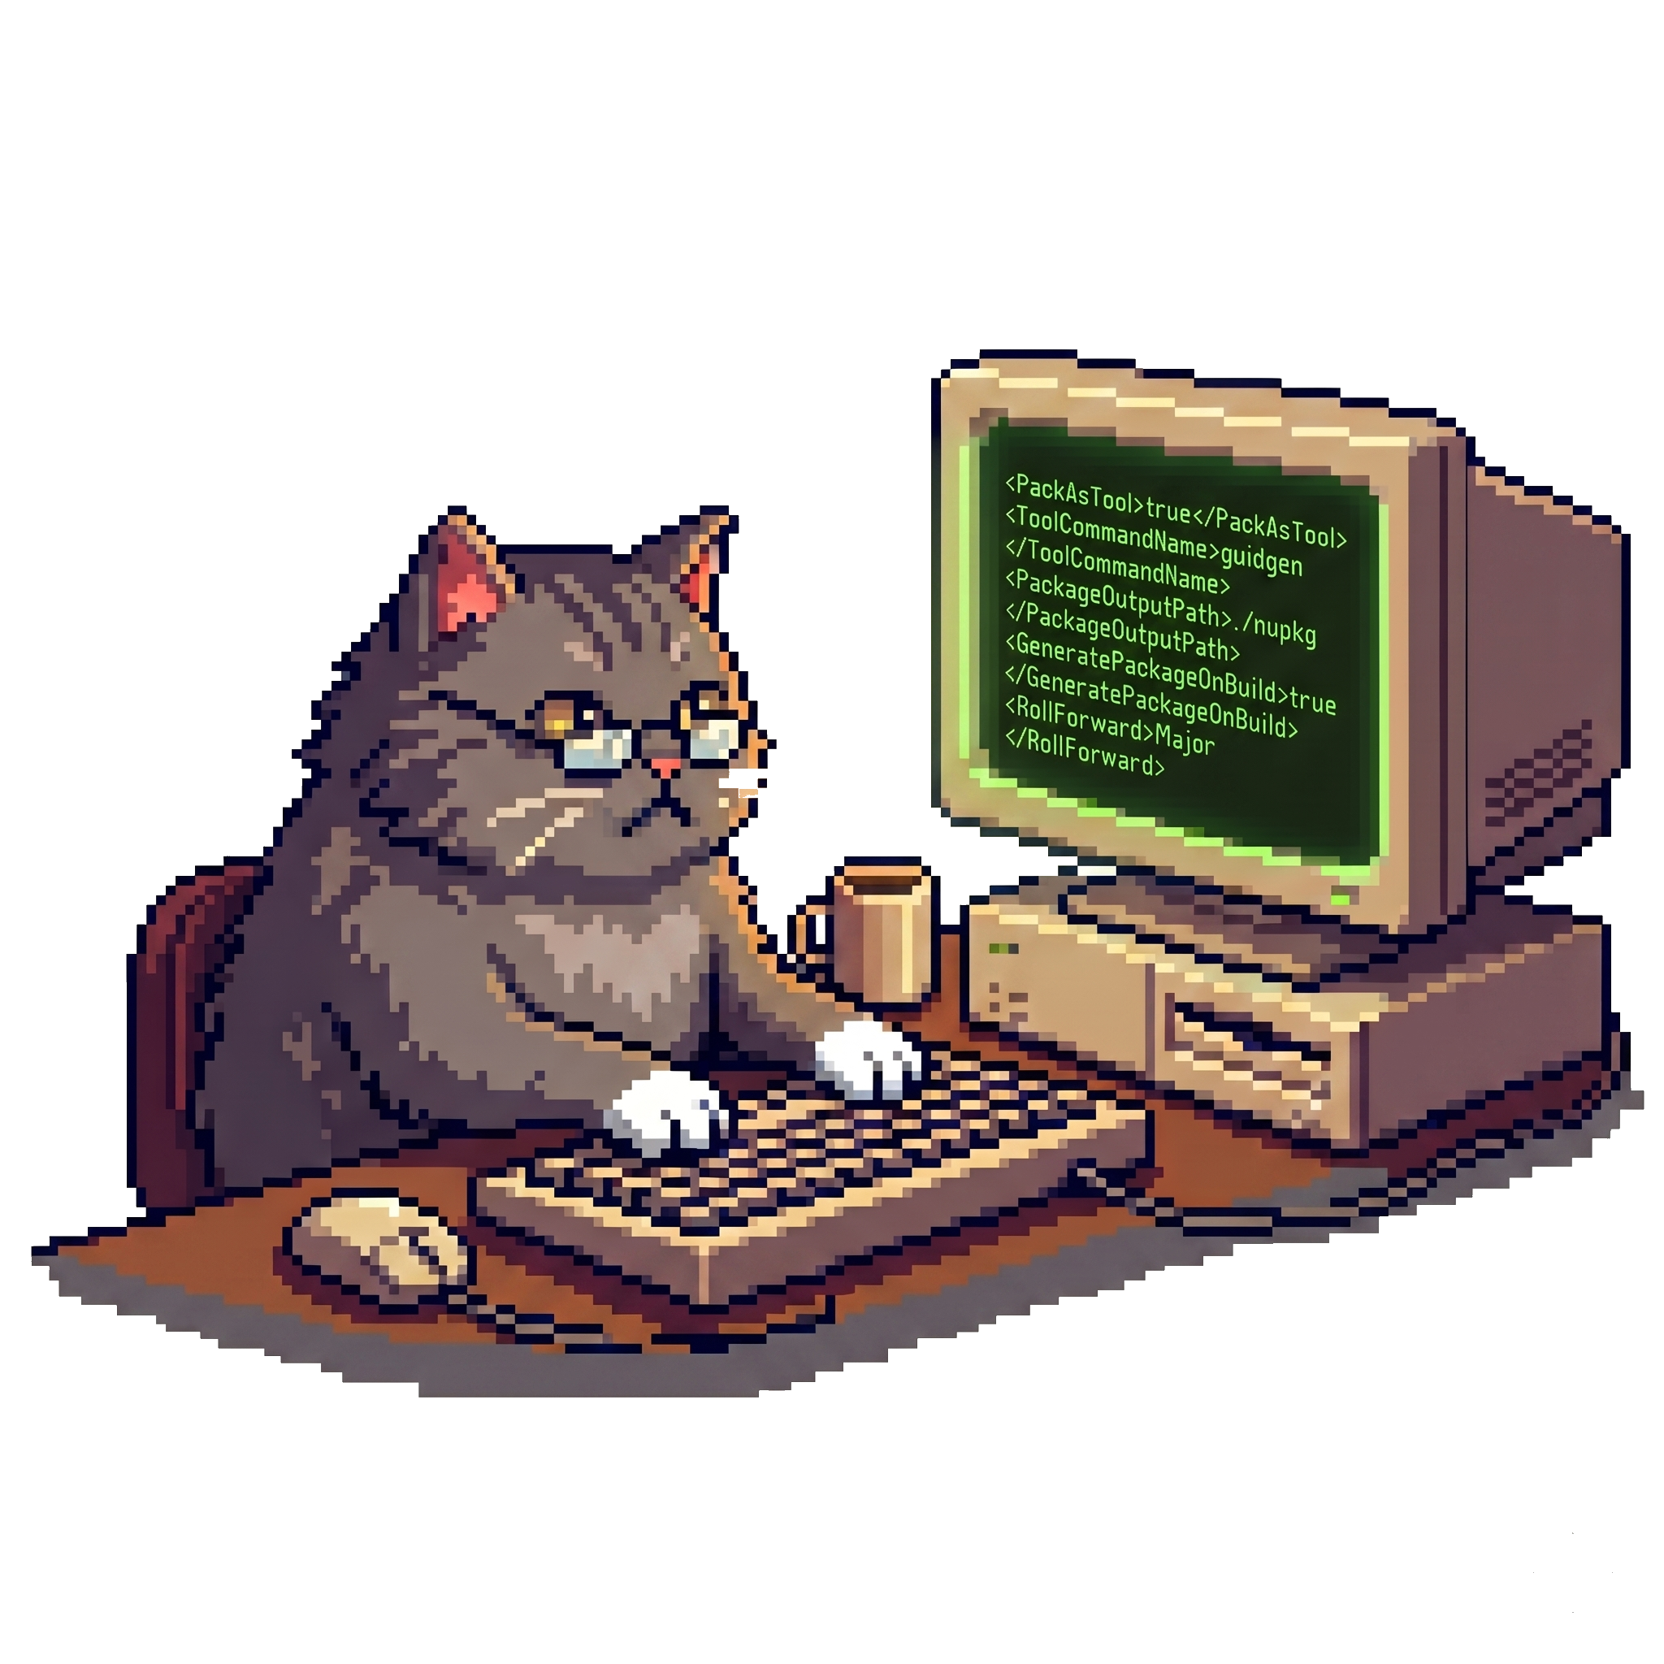
Authoring a .NET CLI tool
Everything is in the .csproj! DEMO
Tool packaging
<PackAsTool>true</PackAsTool>
<ToolCommandName>guidgen</ToolCommandName>
<PackageOutputPath>./nupkg</PackageOutputPath>
<GeneratePackageOnBuild>true</GeneratePackageOnBuild>
Runtime compatibility… or AOT (GuidGen.Aot)
<RollForward>Major</RollForward>
→ Avoid large <TargetFrameworks>

Slide 9

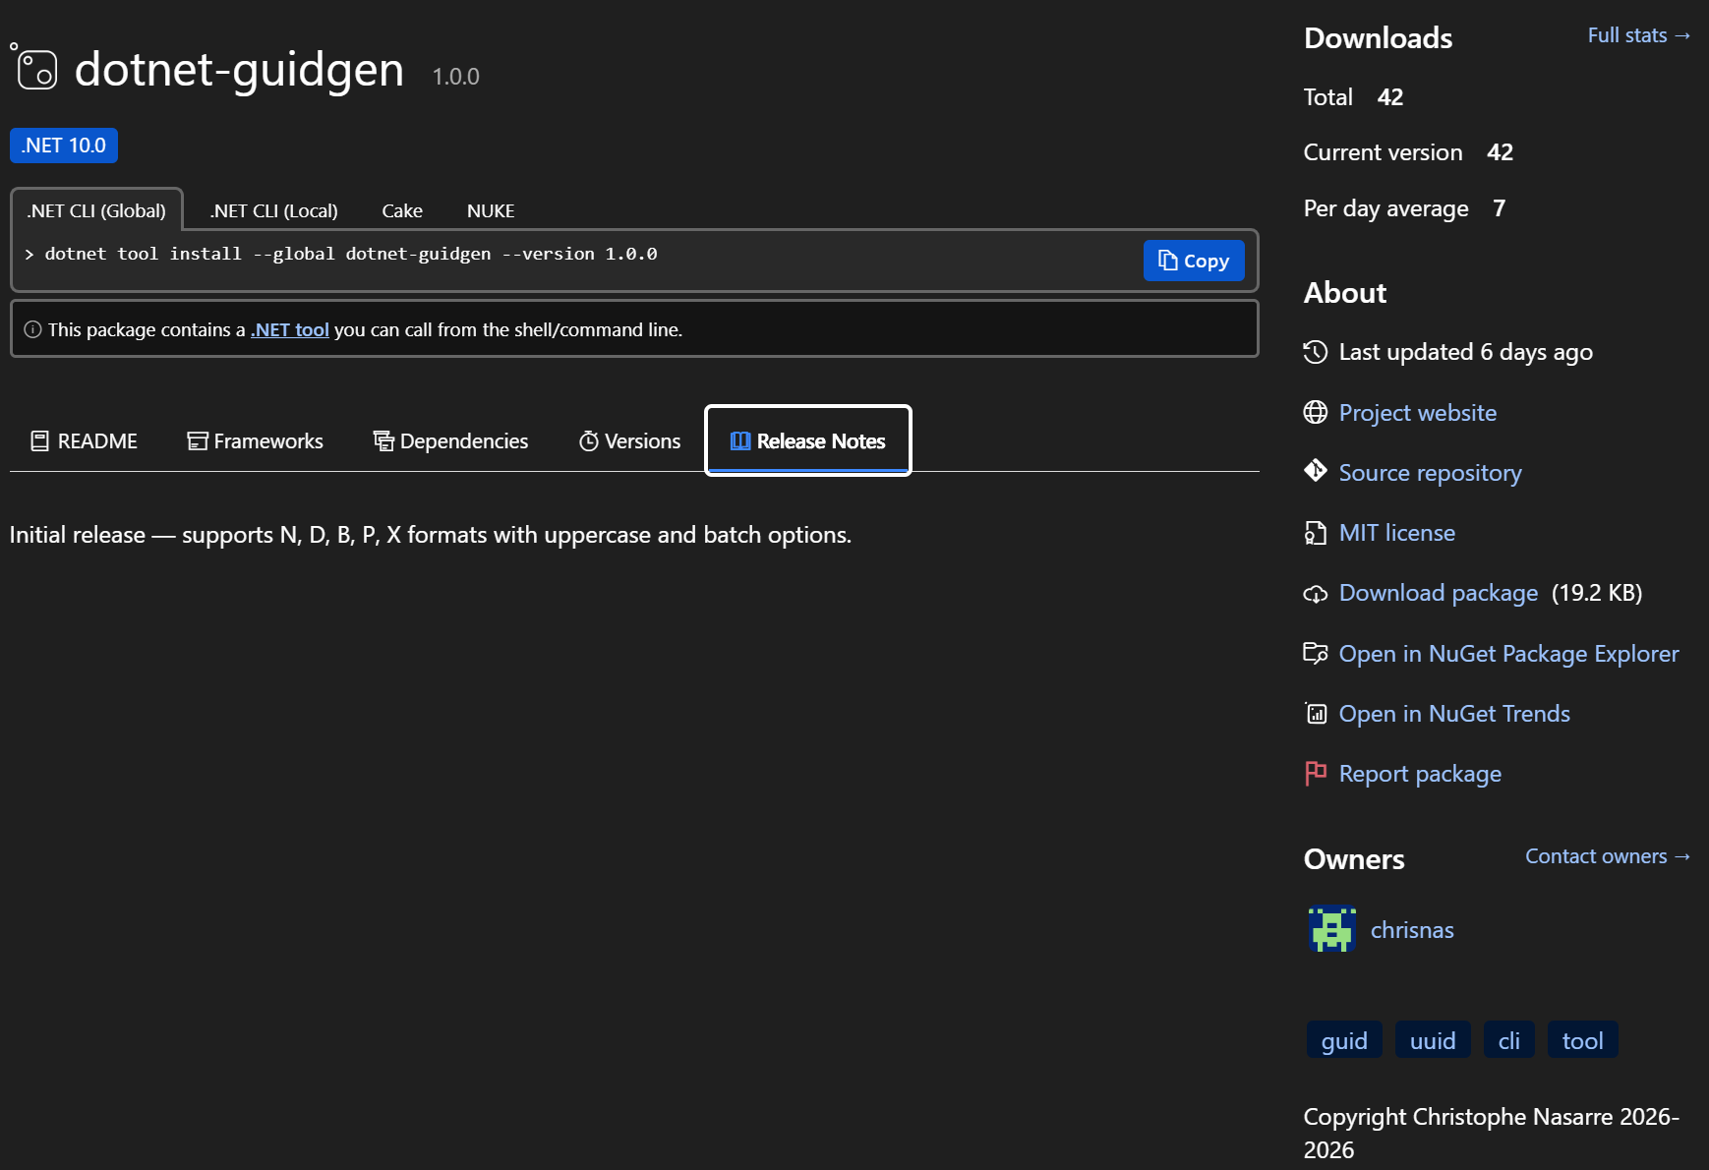
Authoring a .NET CLI tool
<Title>
<Version>
<PackageProjectUrl>
<PackageReadmeFile>
<PackageRepositoryUrl>
<PackageReleaseNotes>

Slide 10
Authoring a .NET CLI tool
<RepositoryType>
<PackageLicenceExpression>
<Owners>
<PackageTags>
<Copyright>

Slide 11

Testing a .NET CLI tool
Uninstall current version if any
dotnet tool uninstall -g dotnet-dstrings
Install from the source folder
dotnet tool install -g dotnet-dstrings --add-source ./dotnet-dstrings/nupkg --version 2.1.0

Slide 12
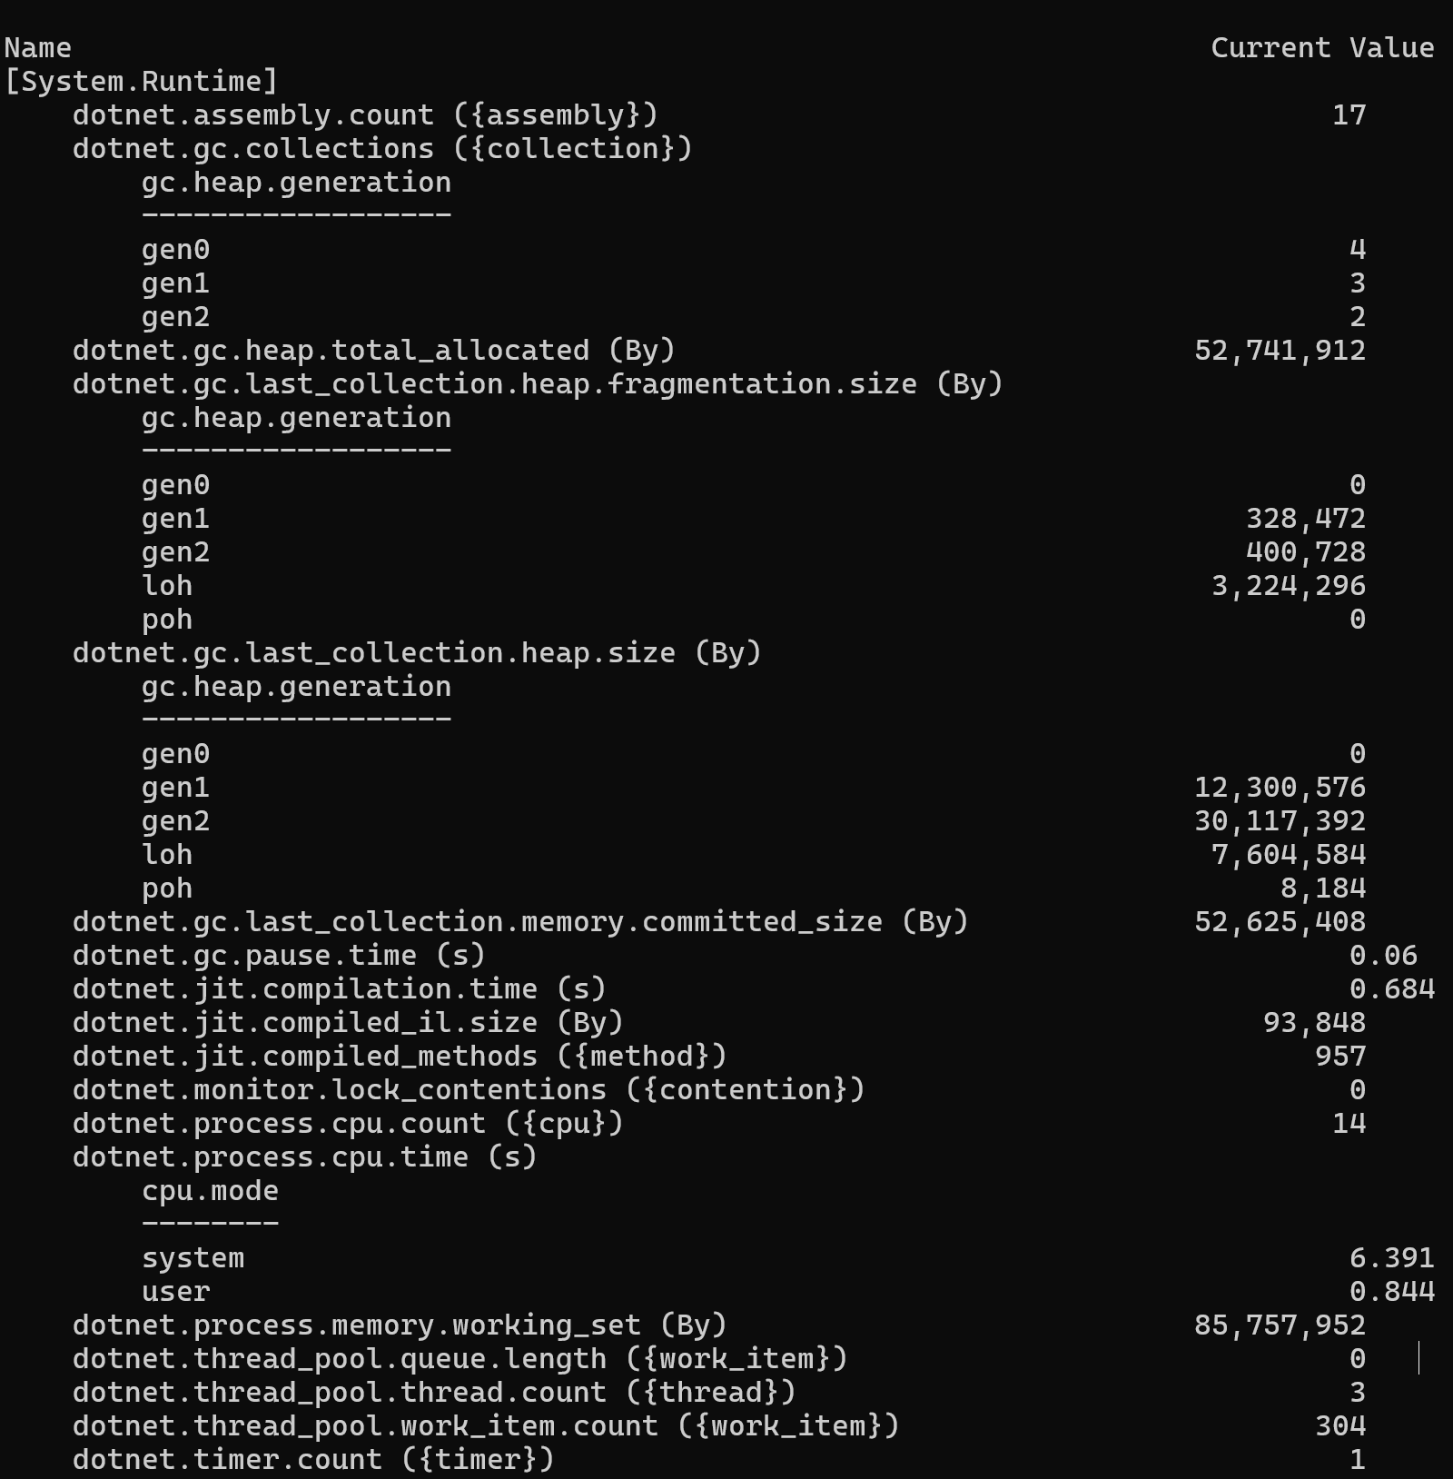
Look inside the CLR (1/2)
Existing Microsoft CLI tools
dotnet-counters — monitor real-time counters and metrics

Slide 13
Look inside the CLR (1/2)
Existing Microsoft CLI tools
dotnet-counters — monitor real-time counters and metrics
dotnet-trace — collect events from BCL/CLR/+ (.nettrace files)

Slide 14
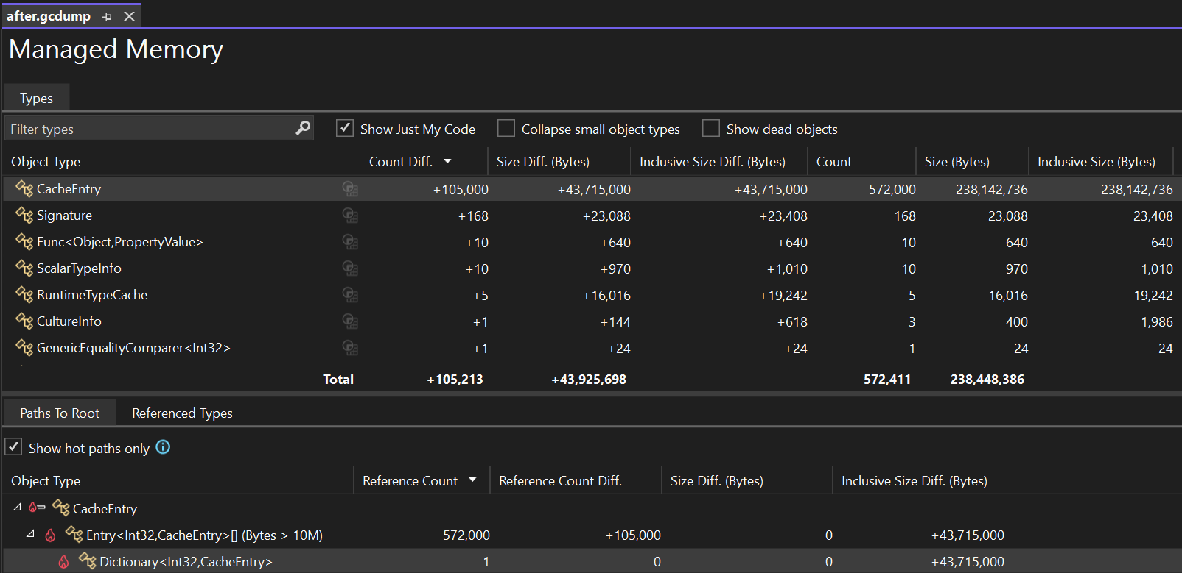
Look inside the CLR (1/2)
Existing Microsoft CLI tools
dotnet-counters — monitor real-time counters and metrics
dotnet-trace — collect events from BCL/CLR/+ (.nettrace files)
dotnet-dump — capture and analyze memory dumps (SOS commands)
dotnet-gcdump — capture GC heap snapshots (lighter than full dumps)

Slide 15
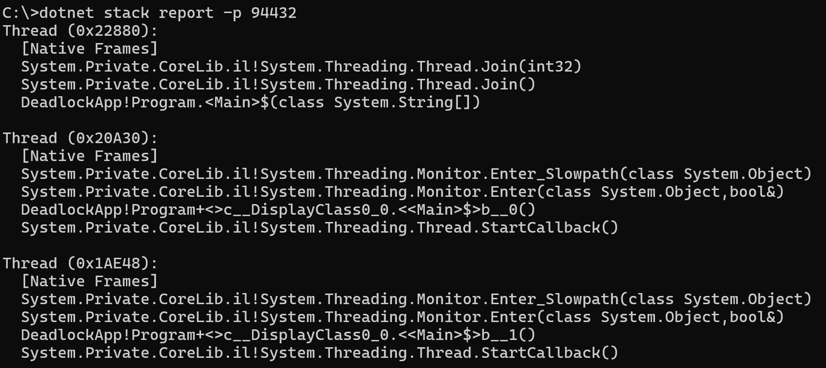
Look inside the CLR (1/2)
Existing Microsoft CLI tools
dotnet-counters — monitor real-time counters and metrics
dotnet-trace — collect events from BCL/CLR/+ (.nettrace files)
dotnet-dump — capture and analyze memory dumps (SOS commands)
dotnet-gcdump — capture GC heap snapshots (lighter than full dumps)
dotnet-stack — show managed stacks of a running process threads
dotnet-sos — install the SOS debugging extension
dotnet-symbol — download symbols, DAC, and modules for debugging

Slide 16
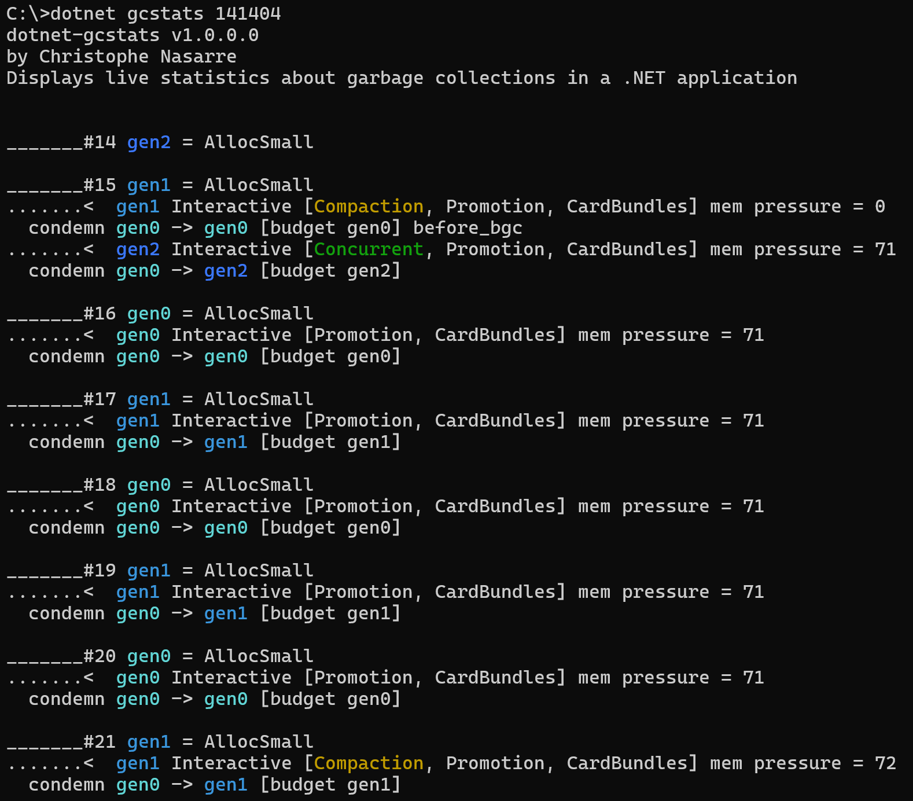
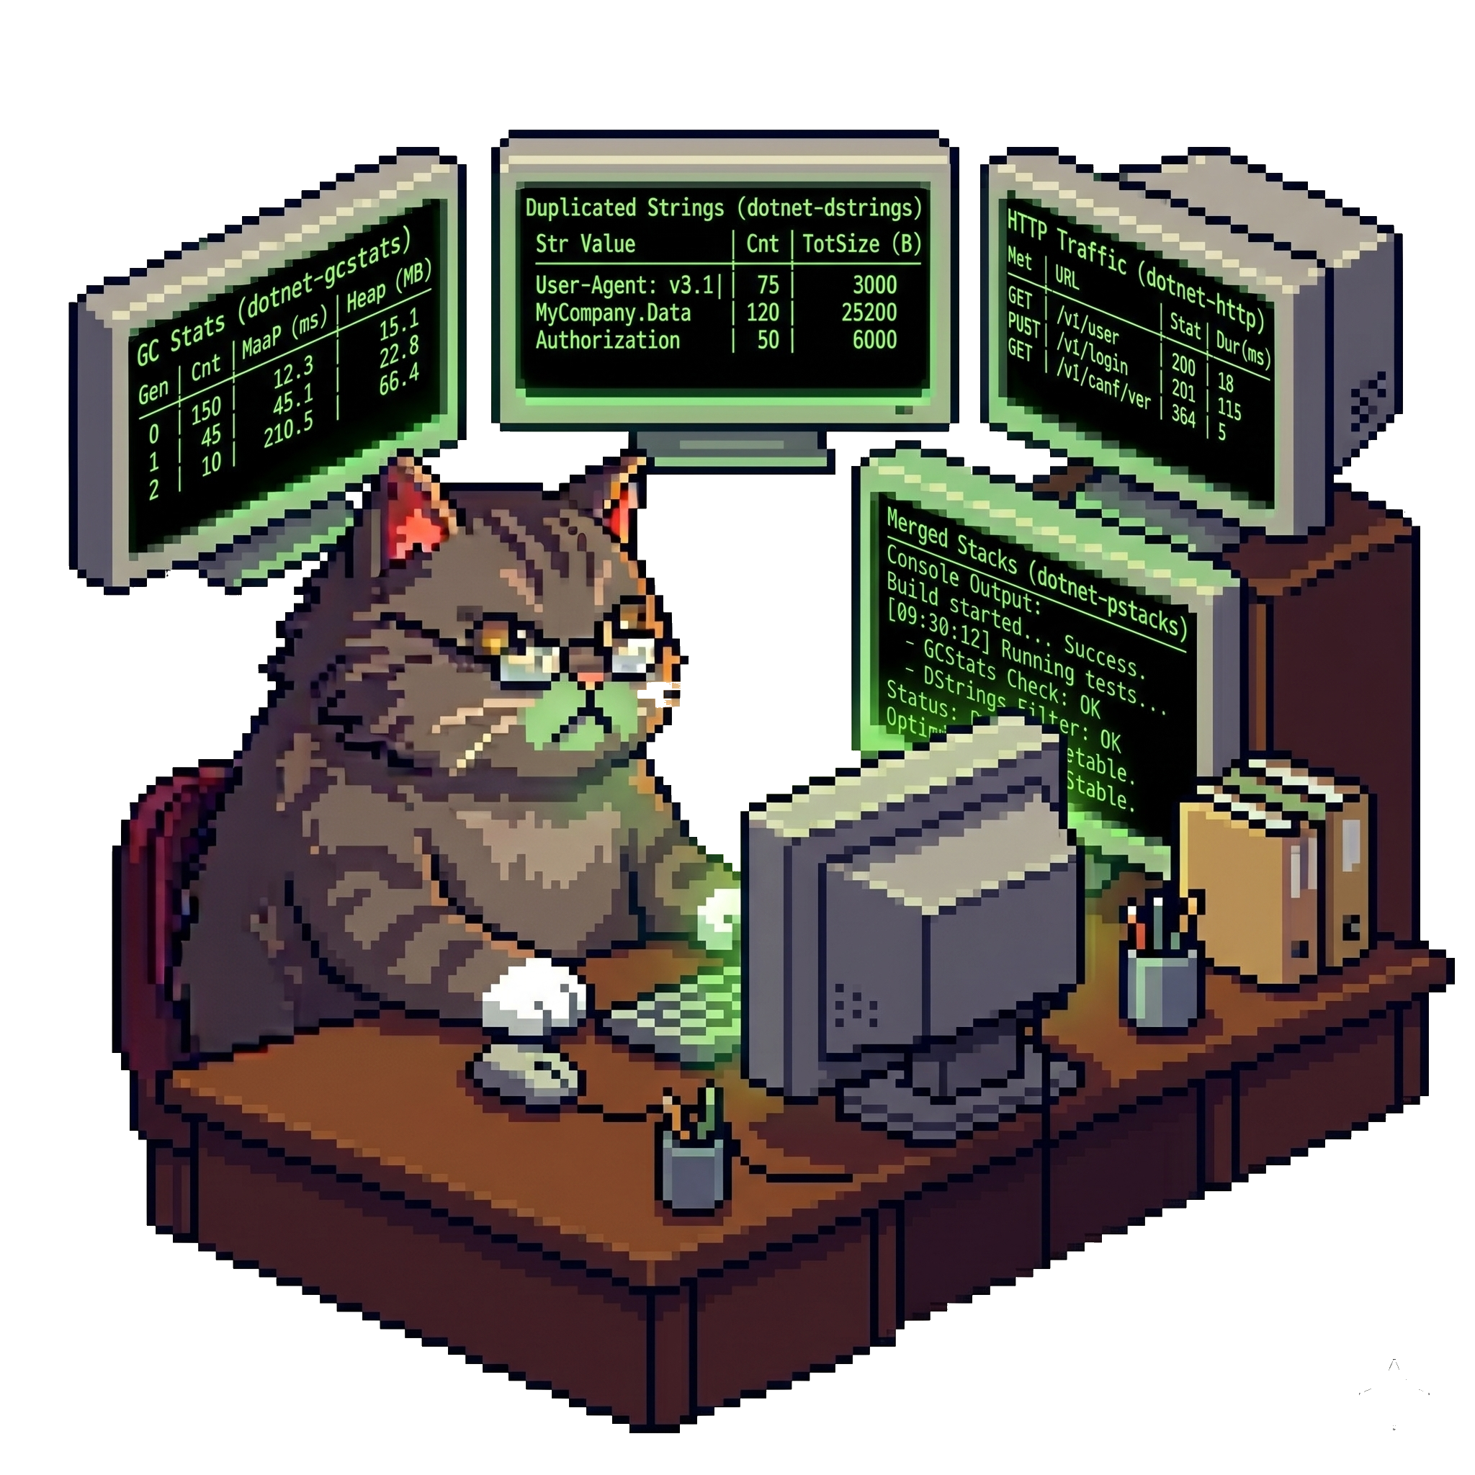
Look inside the CLR (2/2)
Other tools
dotnet-gcmon — monitor GCs in real-time
dotnet-gcstats — monitor GCs in real-time

Slide 17
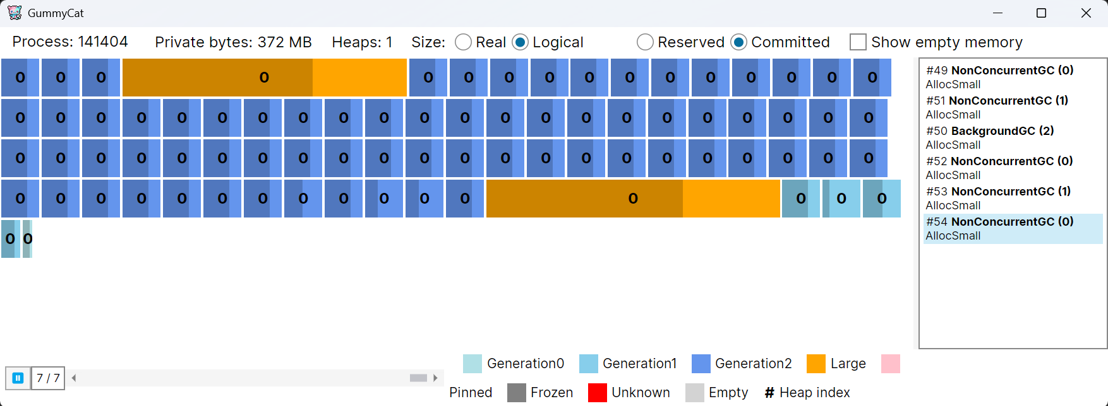
Look inside the CLR (2/2)
Other tools
dotnet-gcmon — monitor GCs in real-time
dotnet-gcstats — monitor GCs in real-time
GummyCat — monitor GCs in a GUI

Slide 18
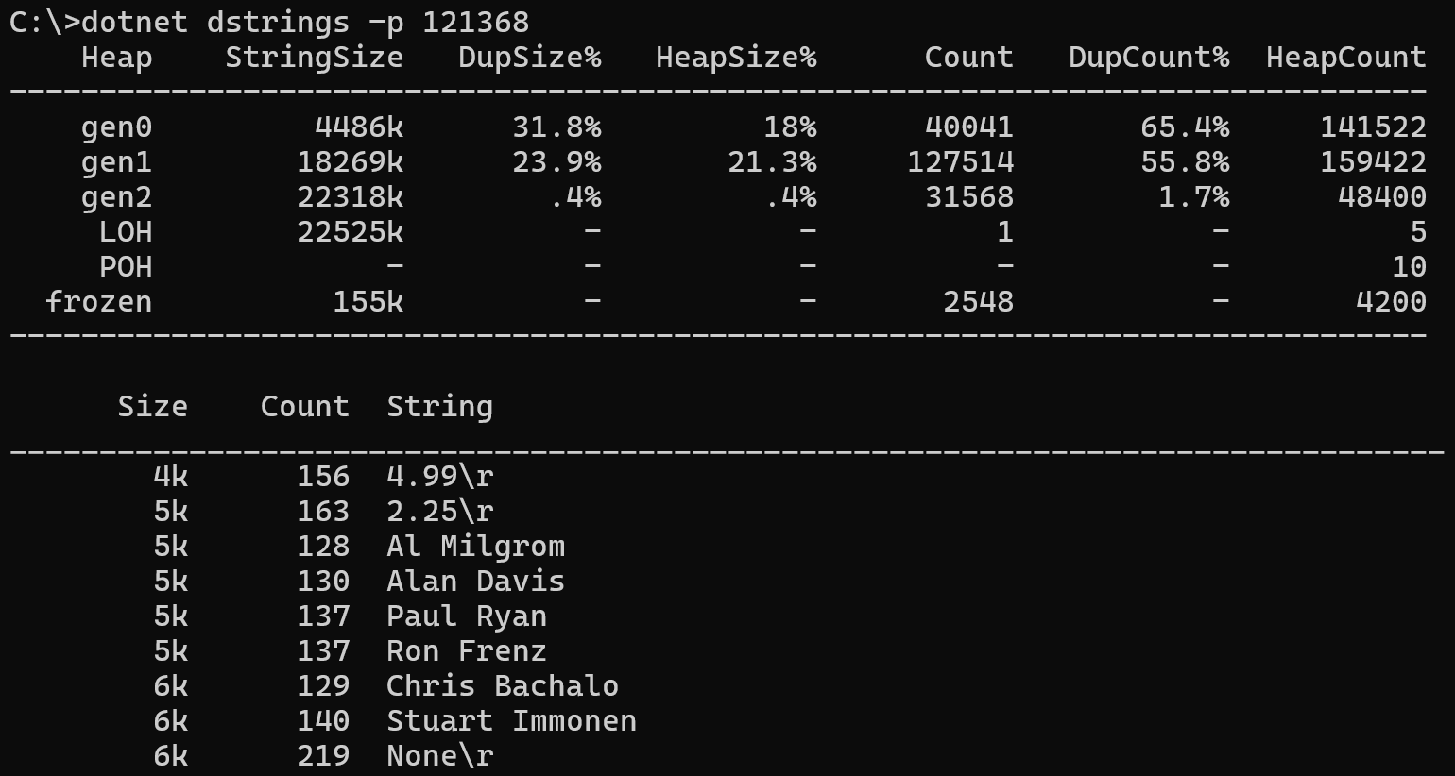
Look inside the CLR (2/2)
Other tools
dotnet-gcmon — monitor GCs in real-time
dotnet-gcstats — monitor GCs in real-time
GummyCat — monitor GCs in a GUI
dotnet-dstrings — look for duplicated strings

Slide 19
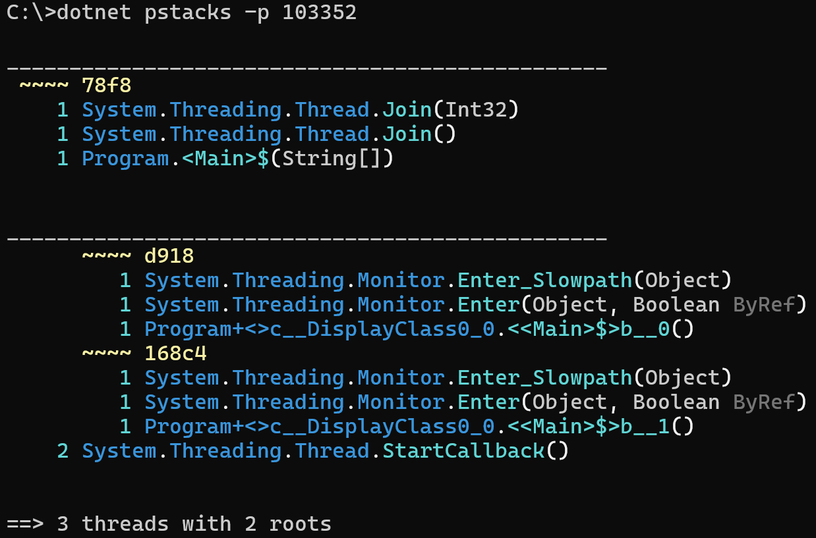
Look inside the CLR (2/2)
Other tools
dotnet-gcmon — monitor GCs in real-time
dotnet-gcstats — monitor GCs in real-time
GummyCat — monitor GCs in a GUI
dotnet-dstrings — look for duplicated strings
dotnet-pstacks — show merged call stacks

Slide 20
Look inside the CLR (2/2)
Other tools
dotnet-gcmon — monitor GCs in real-time
dotnet-gcstats — monitor GCs in real-time
GummyCat — monitor GCs in a GUI
dotnet-dstrings — look for duplicated strings
dotnet-pstacks — show merged call stacks
dotnet-http — monitor outgoing http requests
dotnet-wait — list waits such as lock contention
dotnet-fullgc — trigger a GC

Slide 21
How to look inside the CLR?
Listen to CLR and BCL events
  Look at ClrEtwAll.man file for CLR events (provider + keyword + verbosity)
  Look for EventSource derived class in BCL + documentation + http-related post
Data access with ClrMD
  Memory, thread and more
  Reference Microsoft.Diagnostics.Runtime package
Send commands
  Specific commands are available + special case to trigger a garbage collection

Slide 22
Listen with TraceEvent
Reference TraceEvent
  Ask for provider + keyword + verbosity
Monitored Application
DiagnosticServer
Monitoring tools
static DWORD DiagnosticsServerThread(...)
{
switch(message)
{
case EventPipe:
EventPipeProtocolHelper::HandleIpcMessage()
case ...:
}
}
DiagnosticsClient
EventPipeSession
Named Pipe (Windows)
EventPipe
Domain Socket (Linux)
EventPipeEventSource.All += ...
or
ClrTraceEventParser C# events

Slide 23

Counters/Metrics case
CLR and BCL are emitting Open Telemetry compatible metrics (.NET 8+)
  Look at dotnet-counters
Deprecated CLR and ASP.NET Core counters
Build your own!
  Read Andrew Lock blog series about metrics

Slide 24
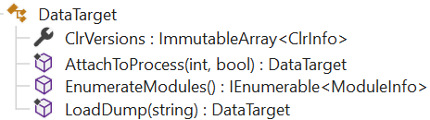
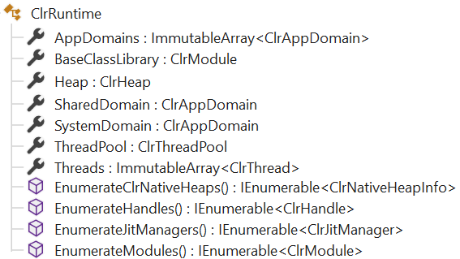
Use ClrMD Luke!
Allow access to live processes and memory dump: DataTarget
Get a ClrRuntime from ClrInfo.CreateRuntime()

Slide 25
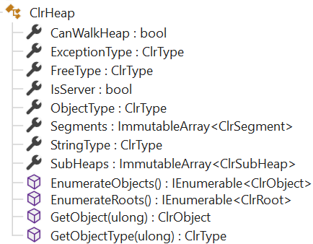
Zoom in the Managed Heap
Everything starts from ClrHeap

Slide 26
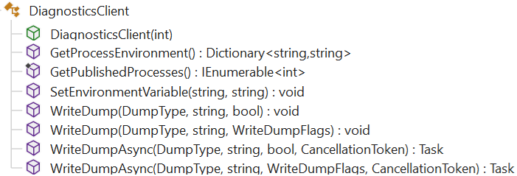
Send a direct command
Use (Microsoft.Diagnostics.NETCore.Client) DiagnosticsClient DEMO

Slide 27
AI & CLI tools
User
prompt
“
Œ
final response
Ž
enriched message
Agent Harness
Models (LLM)
Context Assembler
Skills
tool calls

…

P
‘
tool results
Tool Dispatcher
MCP
servers
model response
’

tools call
tools response
Environment
Notes:
1. The Conversation Loop
The harness manages the turn-based loop between user and model:
The user sends a message.
The harness enriches the message with context (open files, cursor position, linter errors, system rules, etc.) and sends it to the model.
The model responds — either with text for the user, or with tool calls.
If tool calls are present, the harness executes them, collects the results, and sends them back to the model.
Steps 3–4 repeat in a loop until the model produces a final text response with no tool calls.
The response is shown to the user, and the loop waits for the next user message.
This is the heartbeat of the agent. The model never talks directly to the user or directly to tools — the harness mediates everything.
2. Context Assembler
Before each call to the model, the harness assembles the prompt context. This includes:
System prompt: The model's role, persona, rules, coding conventions (like the workspace rule from your CLAUDE.md saying "you are a very senior C++ developer").
Workspace rules: Always-applied rules, file-specific rules, project conventions.
User state: Open files, cursor position, recently viewed files, edit history, linter diagnostics.
Agent skills: Descriptions of available skills the model can choose to invoke.
MCP server metadata: Available MCP tools and resources.
Mode enforcement: Whether the agent is in "Ask mode" (read-only) or "Agent mode" (read-write).
Conversation history: Prior messages and tool results in the session.
The context assembler decides what the model sees. The model cannot perceive anything the harness doesn't inject. This is why, for example, when a subagent is launched, the harness explicitly states: "the subagent invocation does not have access to the user's message or prior assistant steps" — the subagent gets a fresh context window.
3. Tool Dispatcher
When the model emits tool calls (e.g., Read, Shell, Grep, StrReplace), the harness:
Validates the call (correct parameters, file paths, etc.).
Enforces policies (e.g., in Ask mode, write tools are blocked).
Executes the tool against the real environment.
Captures the result (file contents, command output, search results).
Returns the result to the model for the next reasoning step.
The tool dispatcher is what gives the model "hands" — without it, the model can only produce text.

Slide 28
AI: CLI tool → MCP server!
Agents (~models) could simply know how to use CLI tools
  --? could be used by agents to know how to use them
… but better to make it explicit = MCP Server
MCP Server = tools + prompts + resources via a transport (stdio, websockets, …)
Discoverable from agentic tools (Cursor, Copilot, Claude,…)

Slide 29
CLI as an C# MCP Server
dotnet-dstrings use case DEMO
Add ModelContextProtocol and Microsoft.Extensions.Hosting references
Support --mcp command line parameter
Add tools = static classes decorated with [McpServerToolType]
            Decorate static method with [McpServerTool, Description(…)]
            Decorate each parameter with [Description(…)]
Add prompts = static classes decorated with [McpServerPromptType]
            Decorate static method with [McpServerPrompt(Name=…), Description(…)]
            Decorate each parameter with [Description(…)]
Add server.json for easier usage by agentic clients and discovery in nuget.org

Slide 30
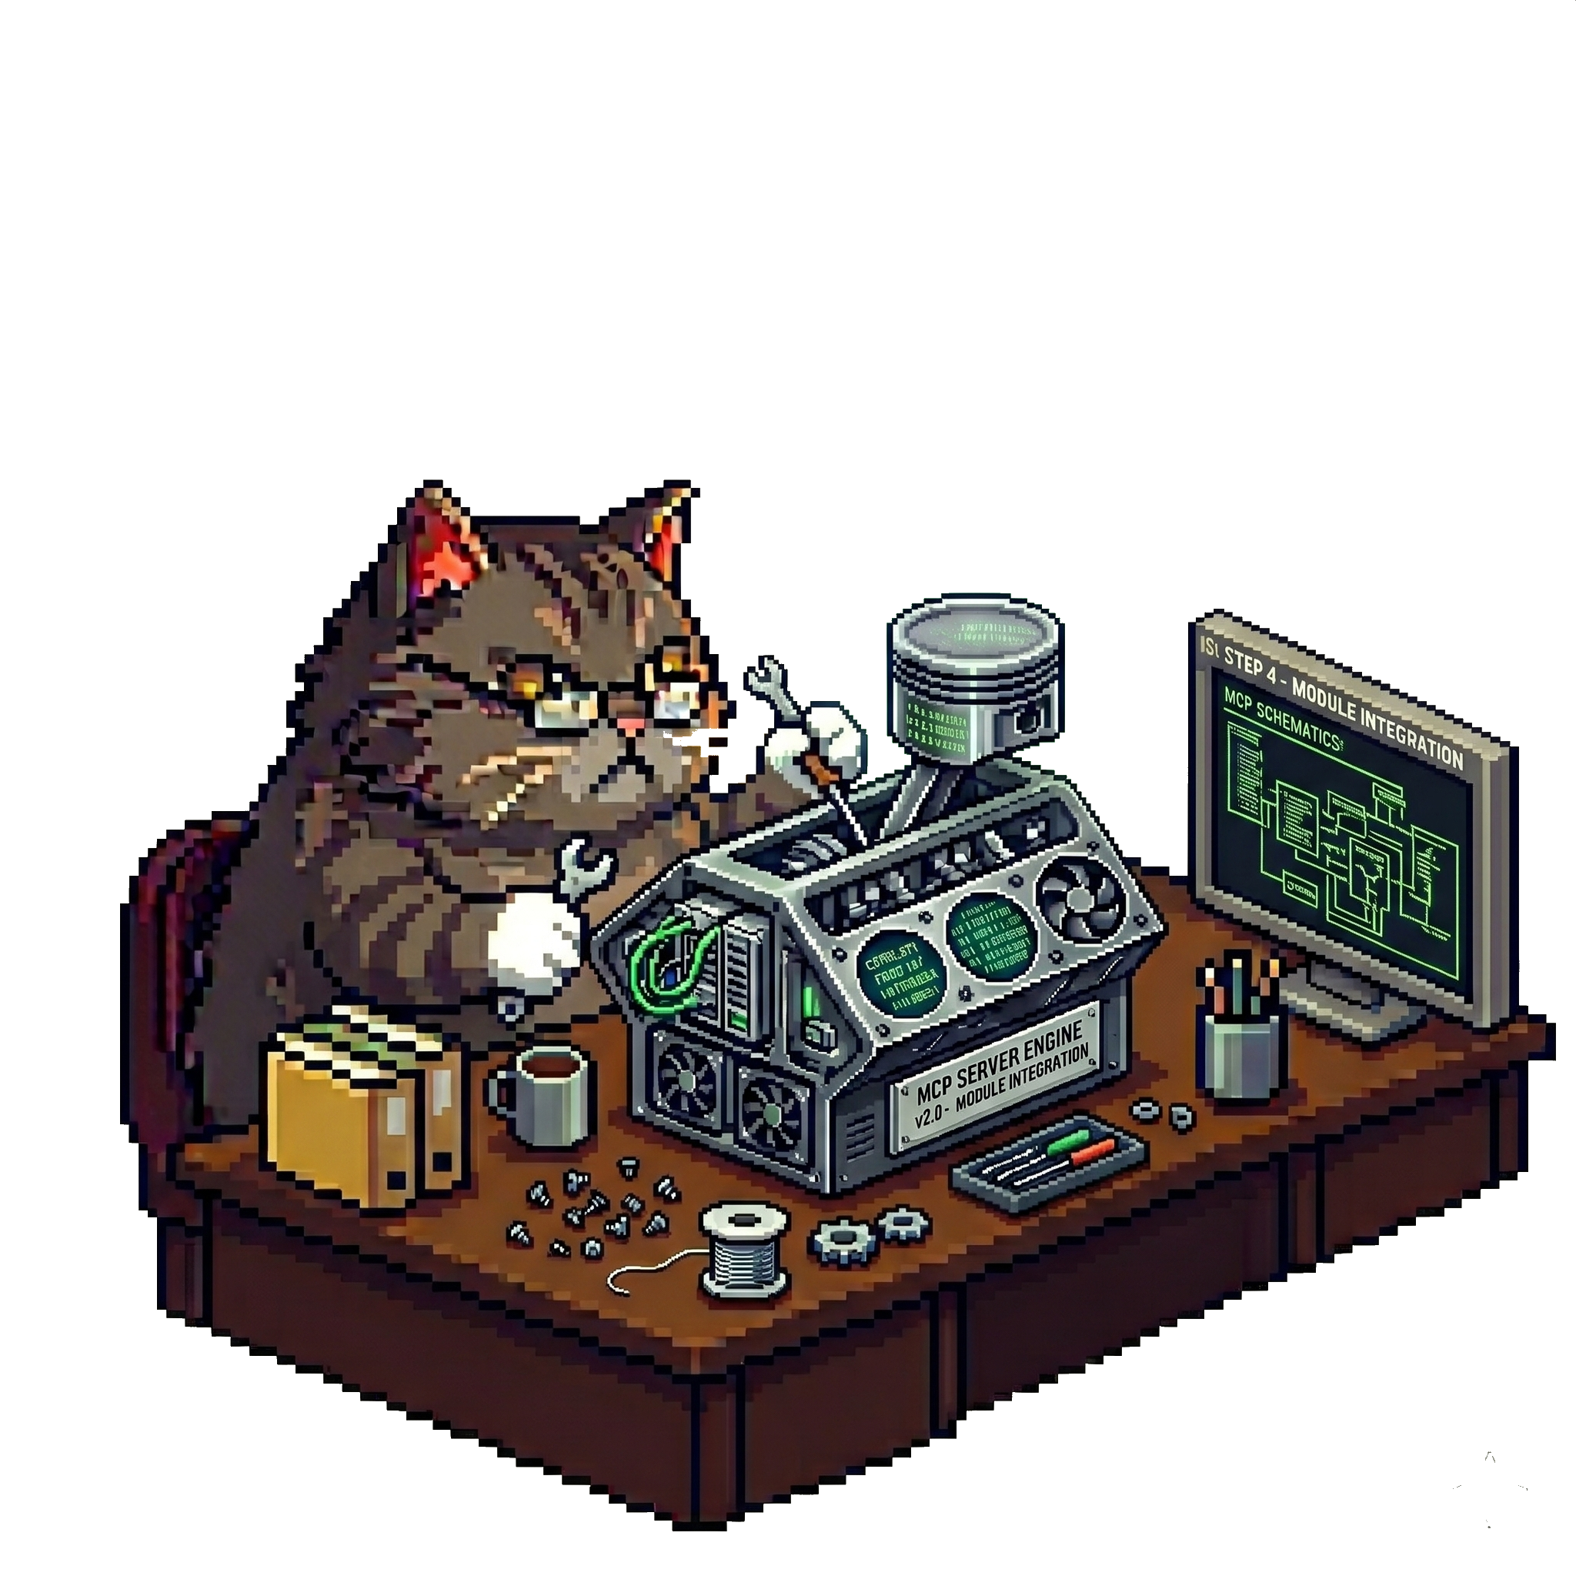
Build a new C# MCP Server
Install the Visual Studio project template
  dotnet new install Microsoft.McpServer.ProjectTemplates
Generate a nuget package
  <PackAsTool>true</PackAsTool>
  <PackageType>McpServer</PackageType> !!! WARNING !!!
Add .mcp\server.json
  Used by clients to know how to start the server

Slide 31
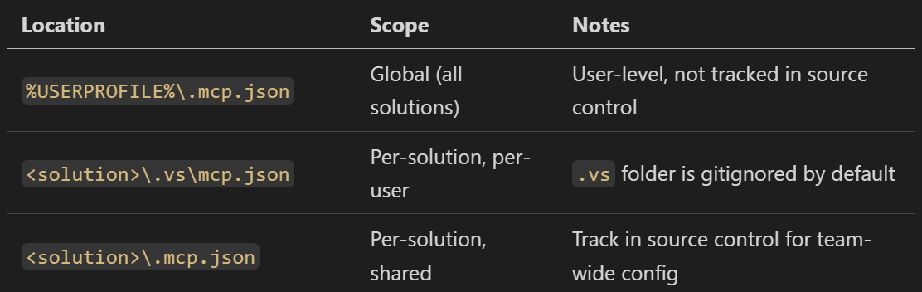
Use MCP Server in VS

Slide 32
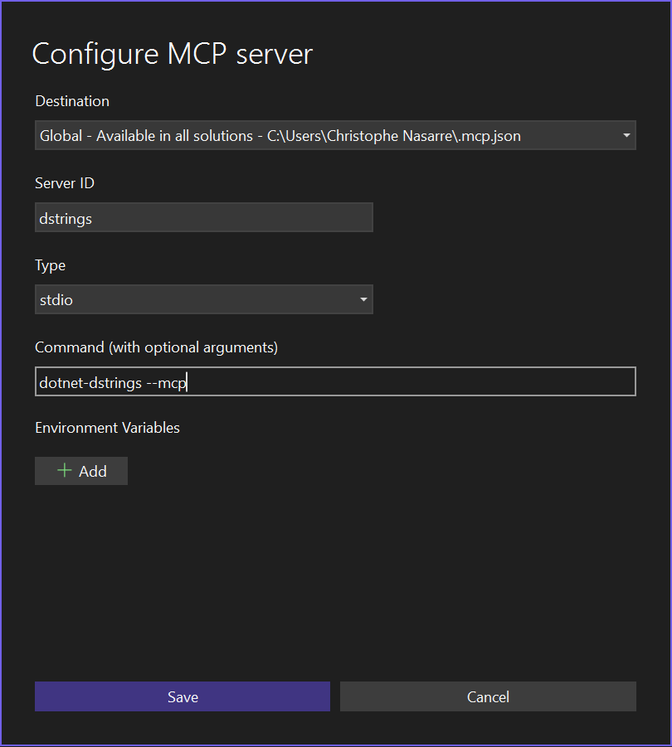
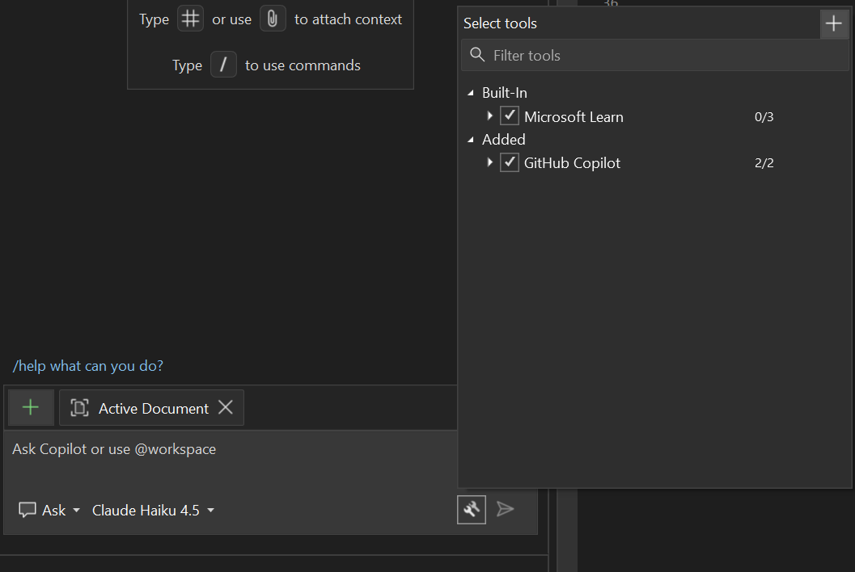
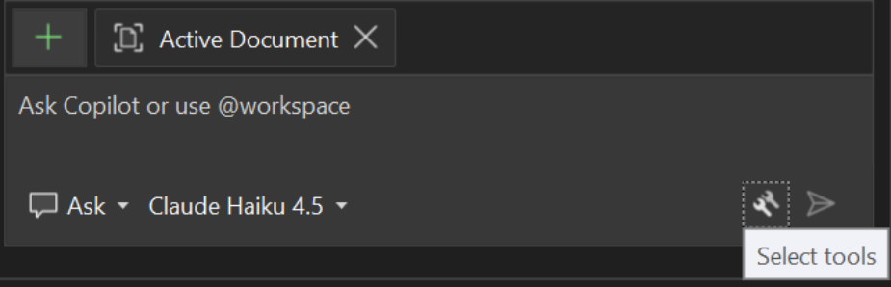
Use MCP Server in VS

Slide 33
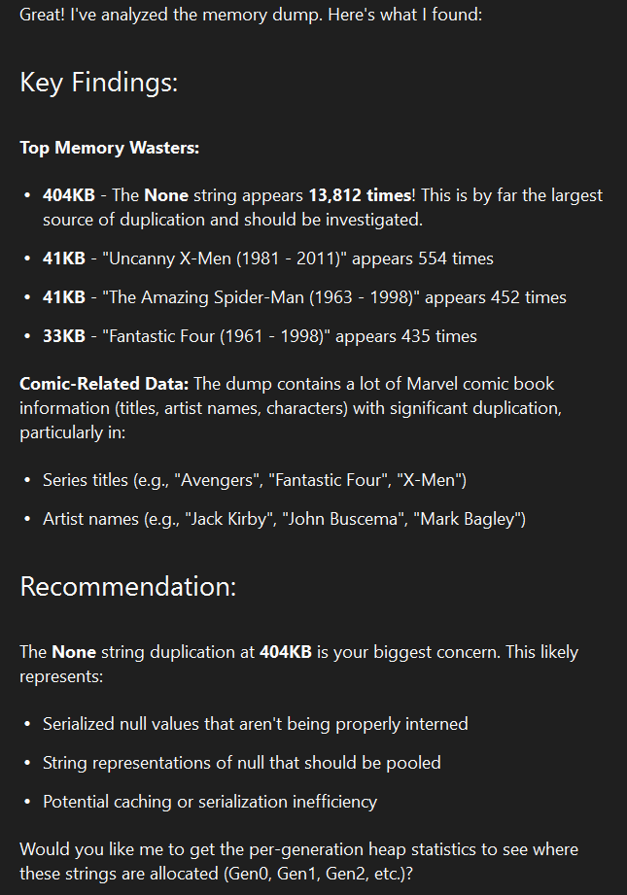
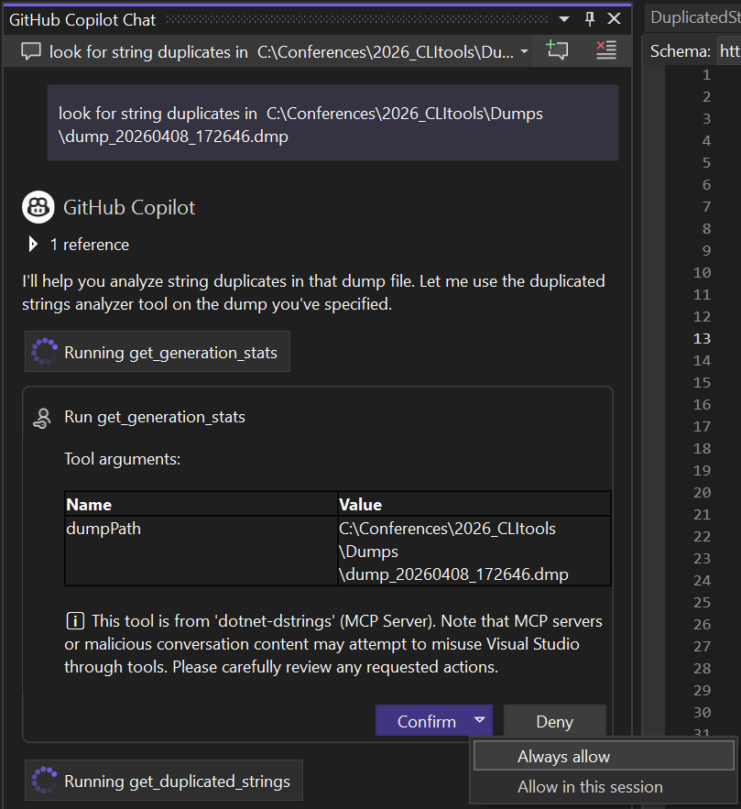
Use MCP Server in VS

Slide 34
Use MCP Server in VS Code
In Powershell
code --% --add-mcp "{\"name\":\"dstrings\",\"type\":\"stdio\",\"command\":\"dotnet-dstrings\",\"args\":[\"--mcp\"]}"

Slide 35
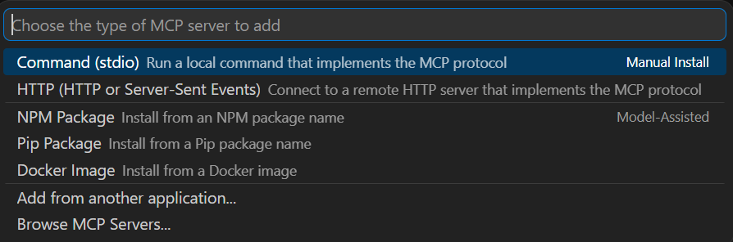
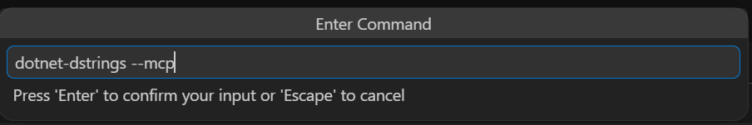
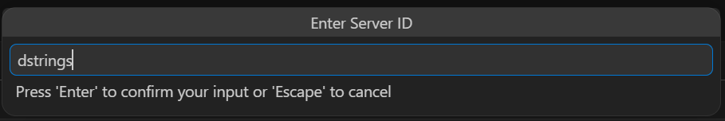
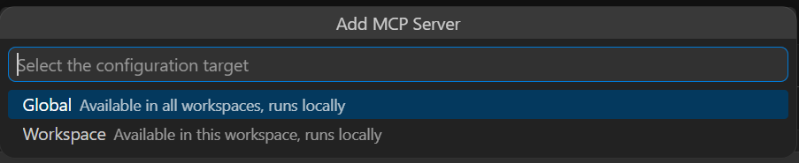
Use MCP Server in VS Code

Slide 36
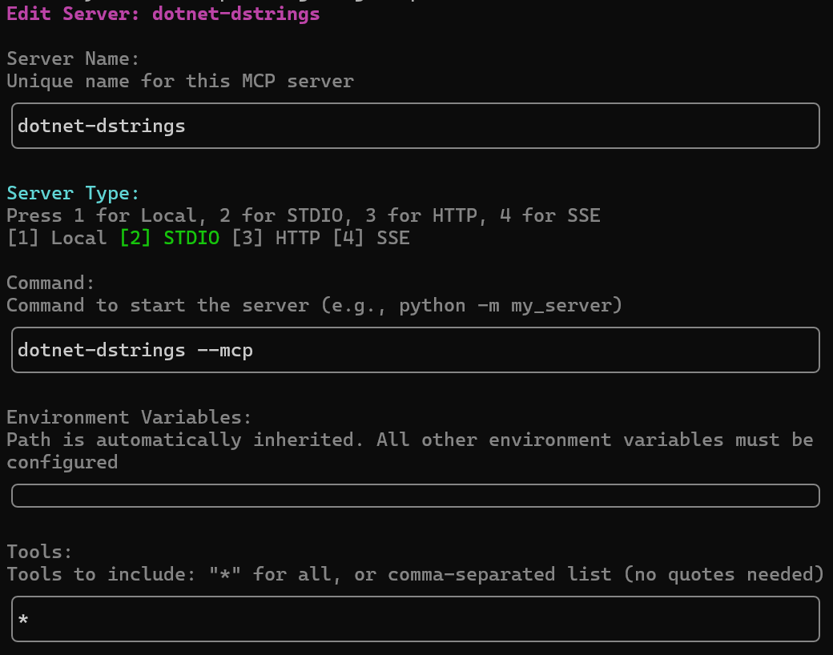
Use MCP Server in Copilot CLI
C:\Users\<user>\.copilot\mcp-config.json
/mcp add

Slide 37
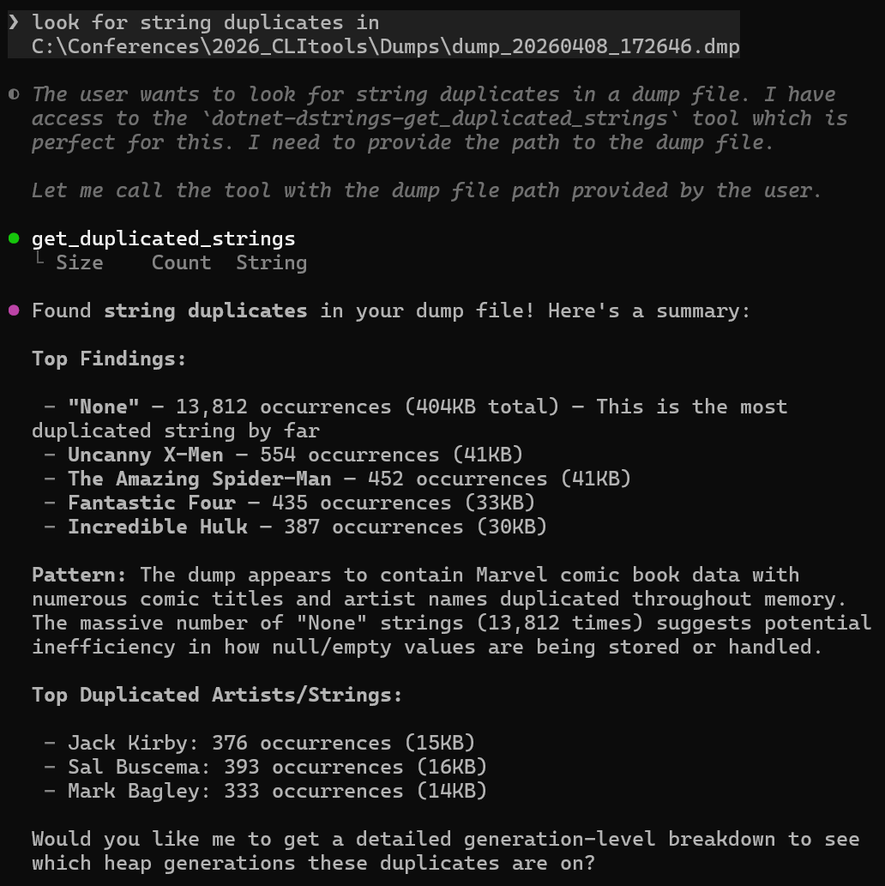
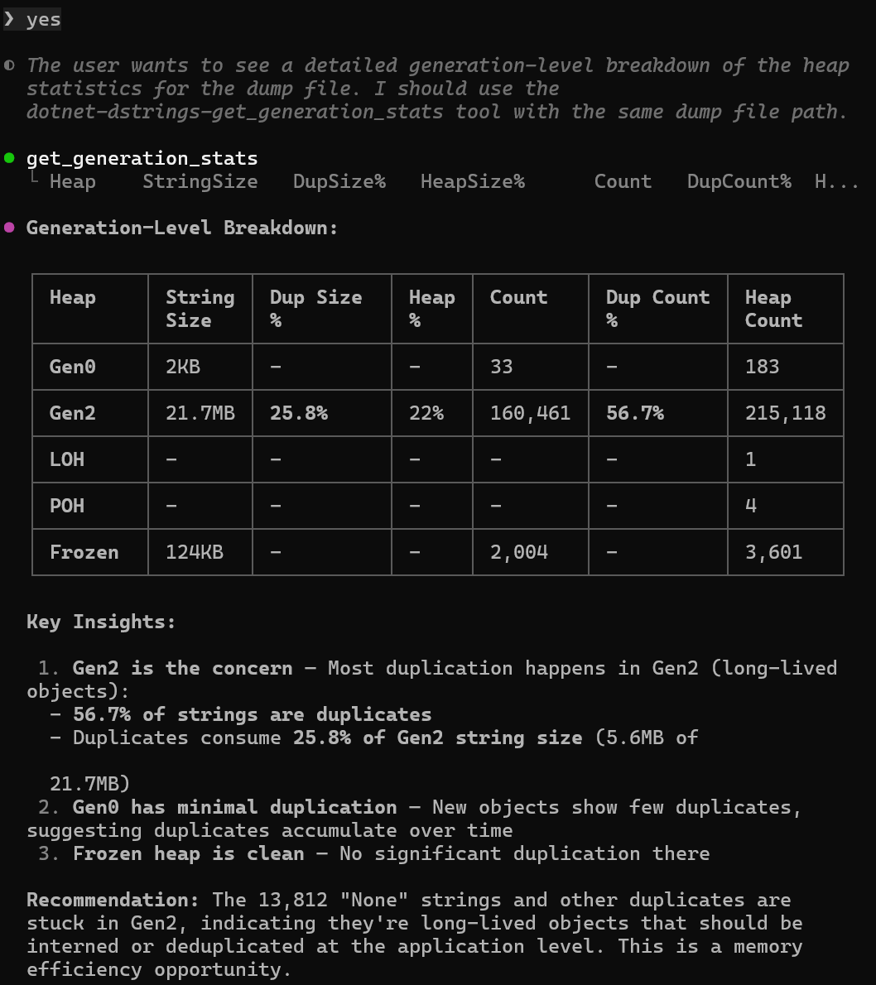
Use MCP Server in Copilot CLI

Slide 38
Use MCP Server in Cursor
C:\Users\<user>\.cursor\mcp.json
{
"mcpServers": {
"dstrings": {
"command": "dotnet-dstrings",
"args": ["--mcp"]
}
}
}

Slide 39
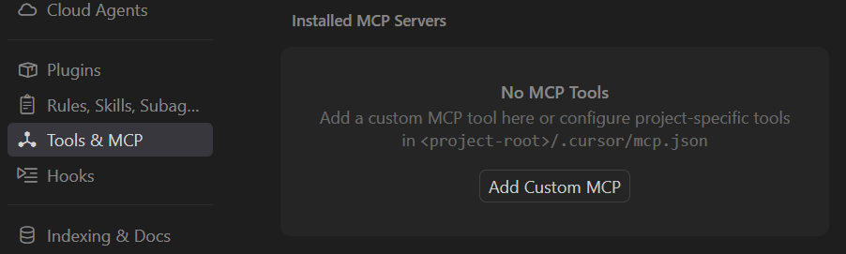
Use MCP Server in Cursor
In Cursor Settings

Slide 40
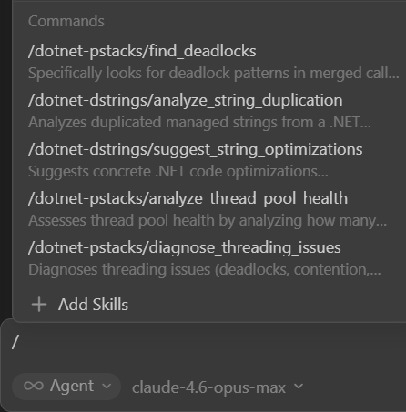
Use MCP Server in Cursor
Hint: find the prompts with /

Slide 41
Use MCP Server in Claude
claude mcp add -s user dstrings -- dotnet-dstrings --mcp
C:\Users\<user>\.claude.json
"mcpServers": {
"dstrings": {
"type": "stdio",
"command": "dotnet-dstrings",
"args": ["--mcp"],
"env": {}
}
}

Slide 42
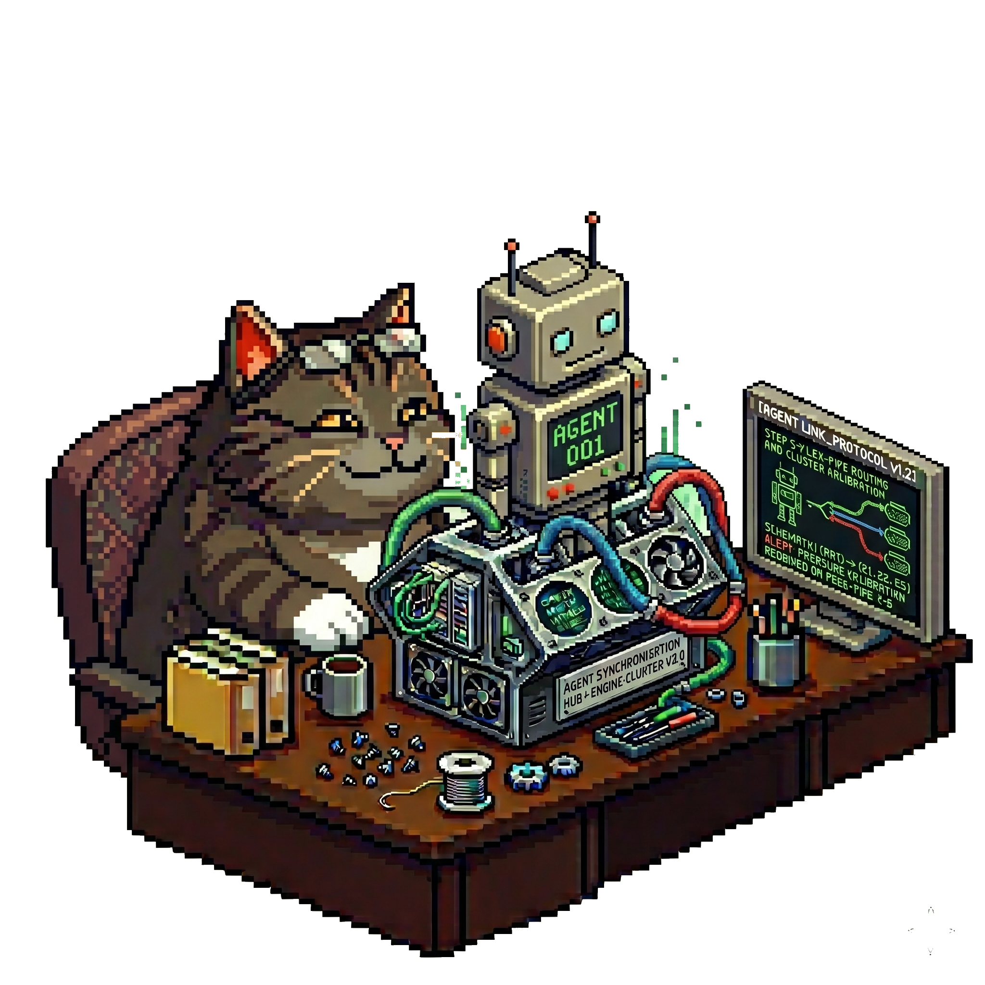
Use your skills Luke!
What if you can’t change the .NET CLI tool?
  Microsoft ones
  Third-party ones
  Keep your own as CLI tool: <PackageType>McpServer issue
Create a skill to orchestrate tools usage DEMO
---
name: dotnet-memory-analysis
description: >-
Analyze .NET application memory issues using CLI diagnostic tools…
---

Slide 43
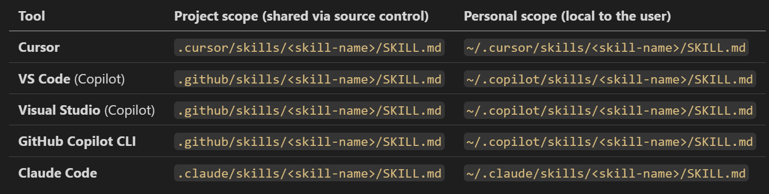
Install your skill
SKILL.md location

Slide 44
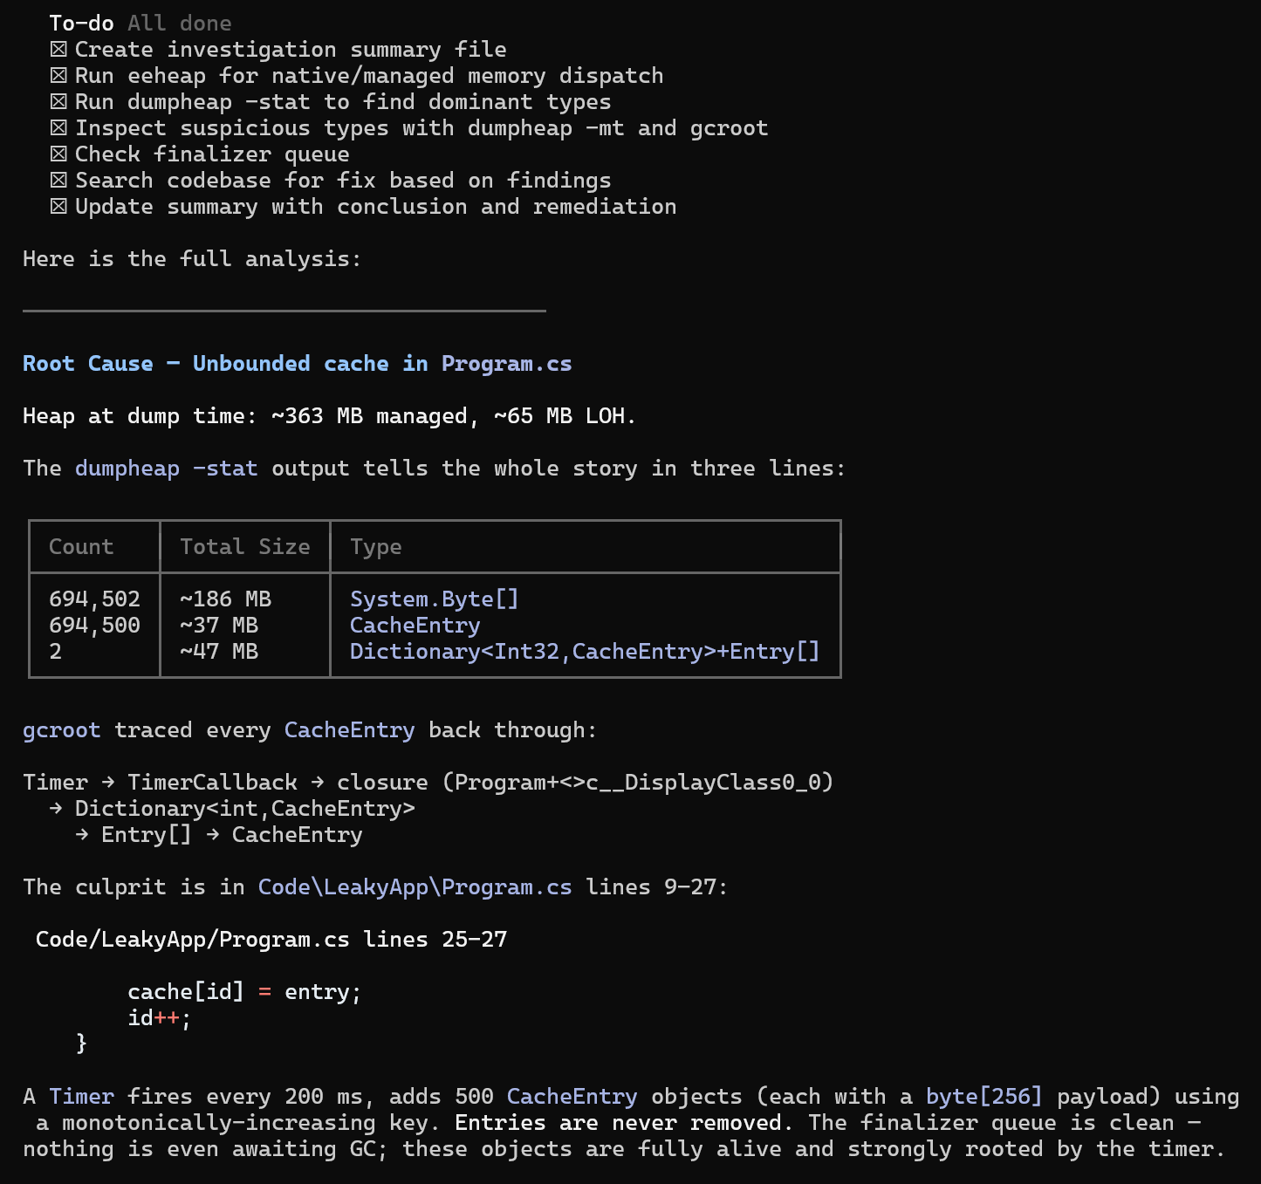
It is working :^)
The leakyApp seems to consume too much memory.
Analyze the problem and provide guidance to fix it.

Slide 45
It is working :^)
The leakyApp seems to consume too much memory.
Analyze the problem and provide guidance to fix it.

Slide 46
It is working :^)
The leakyApp seems to consume too much memory.
Analyze the problem and provide guidance to fix it.

Slide 47
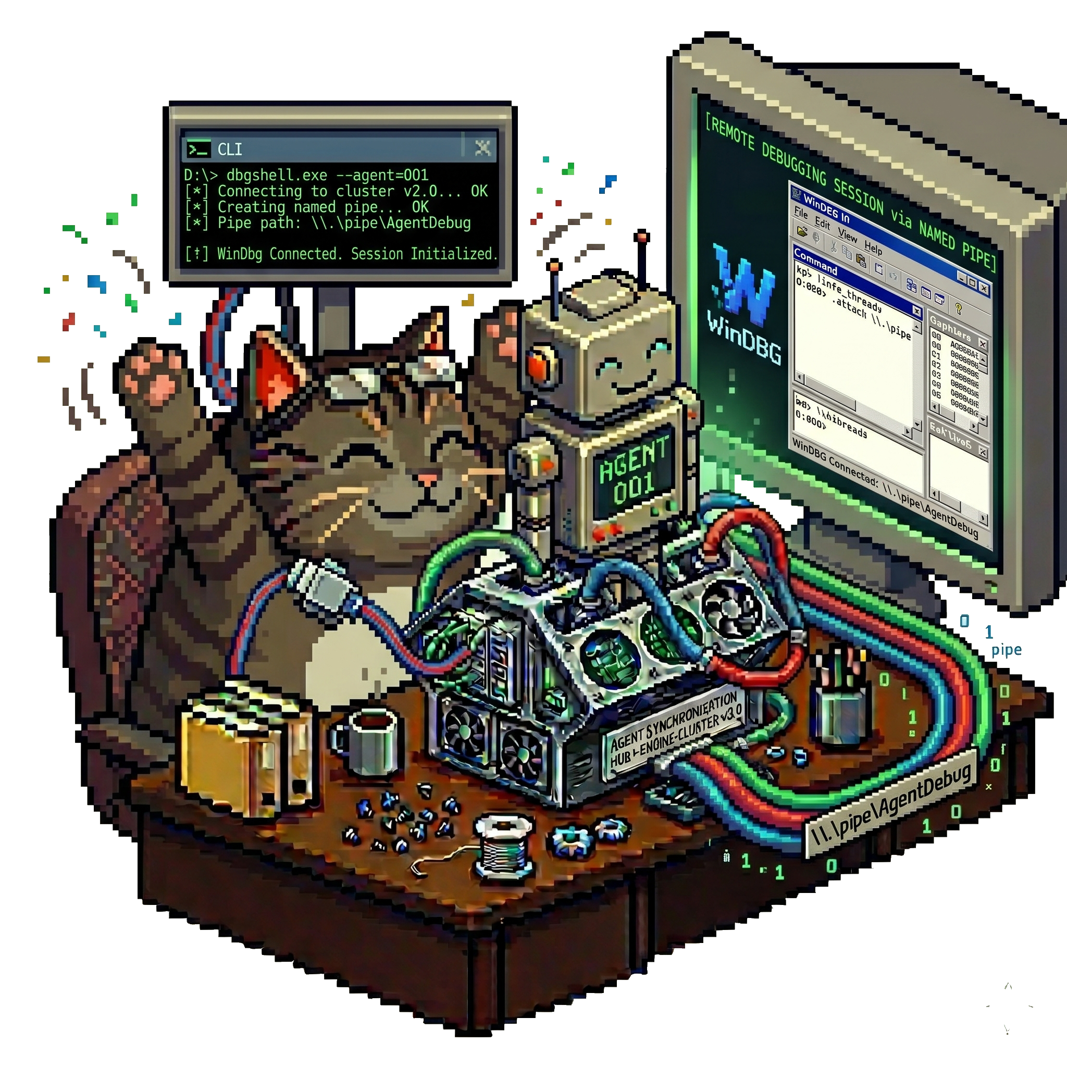
How to interact with GUI?
Windbg-bridge
  Provide a SKILL.md to “drive” the agent
  WinDBG extension to create a named pipe
  CLI tool to connect the named pipe

Slide 48
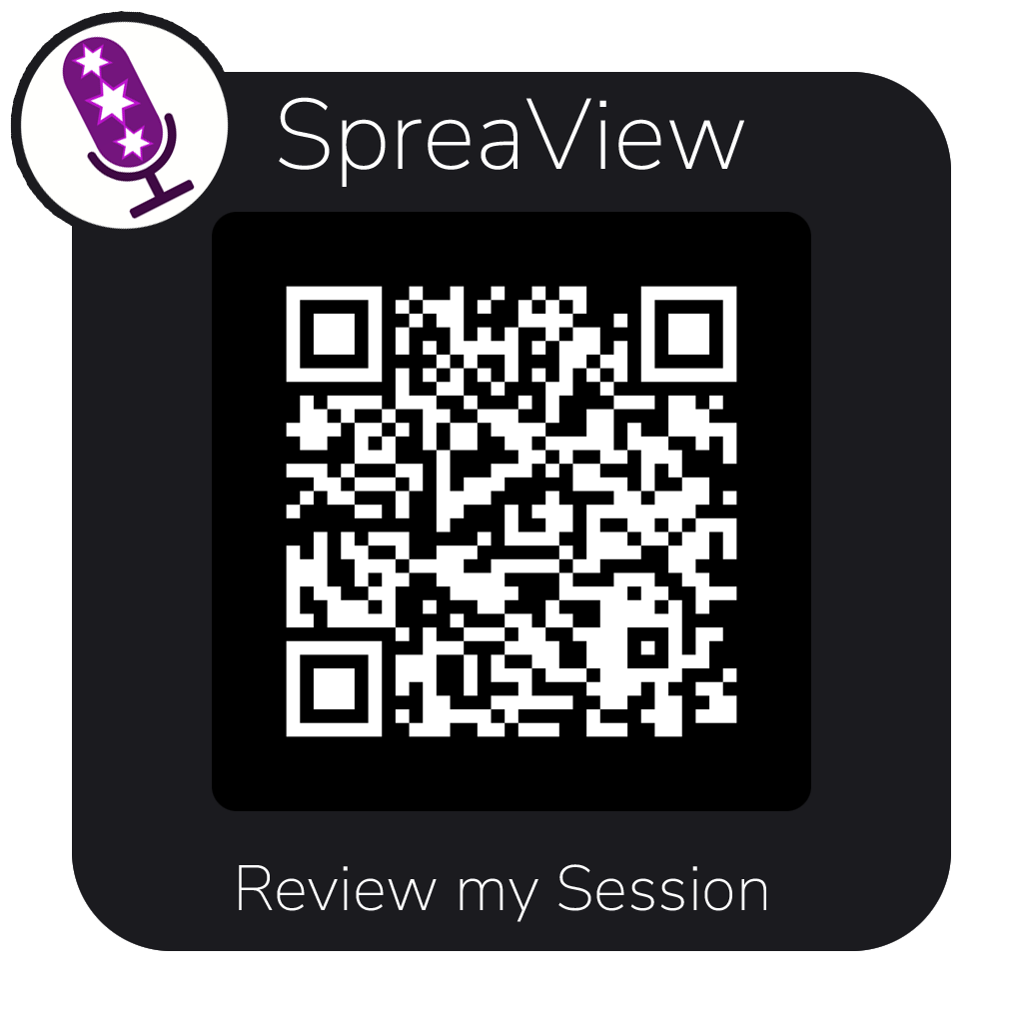
Resources
  Microsoft documentation
  https://learn.microsoft.com/en-us/dotnet/core/tools/global-tools
  https://learn.microsoft.com/en-us/dotnet/core/tools/global-tools-how-to-create
  Andrew Lock blog series
  My Blog
  https://chrisnas.github.io
  This content (code + slides)
  https://github.com/chrisnas/TechoramaNetherland2026

